Slide 1
Enlist Weed Control System Update
2023

Slide 2
Enlist Topics
Latest updates
Enlist® weed control system overview: herbicides and traits
Enlist® Ahead commitment to stewardship
Weed management with the Enlist system
Enlist® herbicides: label highlights
Farmer feedback

Slide 3
Enlist® System Update

Slide 4
Enlist® Weed Control System – Growing For The Future
2022 Enlist E3® soybean acres will build on >45% 2022 share; quickly headed toward 50% market share!
Corteva Agriscience™ seed brands accelerated conversion to Enlist E3 – hard push toward 2025 portfolio goals
Enlist® Corn “re-launch” in 2023 – new market on the horizon for Enlist® herbicides!
120+ Enlist E3® licensees (available listing) and multi-channel brands (Brevant® brands at retail!) add to herbicide opportunity!
New southern strategy to accelerate Enlist E3 conversion and reinvigorate Enlist® cotton business!

Slide 5
Enlist® weed control system is changing the trait herbicide game
Enlist One® herbicide = largest product in the US crop protection portfolio by sales; delivering value to thousands of farmers each year
Value being delivered to farmers:
Elite germplasm combined with Enlist® weed control system
Near-zero volatility and reduced drift
Tank-mix flexibility with glufosinate
More freedom to spray for applicators
Reliable supply from U.S.-based production
Proven track record:
- neighbor-friendly product
- launched responsibly
- university & third-party tested
- delivers results, not excuses
- provides farmers with a better choice!

Slide 6
2022 – Enlist® weed control system Growth continues to accelerate!
More than 50MM acres sprayed with Enlist® herbicides since 2017
5th consecutive year of market share gains
Increased spray rate of Enlist herbicides on Enlist® crops to >80% in 2022 season
45% trait penetration for Enlist E3® soybeans in 2022
Clear contrast in the countryside of dicamba characteristics vs. 2,4-D choline characteristics
Reliable supply of 2,4-D choline in 2022

Slide 7
Enlist® cotton
Enlist® cotton is exclusively available in PhytoGen® brand varieties.
The Enlist cotton trait in PhytoGen brand varieties launched in 2016, with Enlist® herbicides for commercial use on Enlist cotton beginning in 2017.
The PhytoGen portfolio has completed a rapid trait transition to cotton varieties containing the Enlist® trait.
Provides the most advanced herbicide trait system in cotton.
Herbicide Tolerances
2,4-D choline
Glyphosate
Glufosinate

Slide 8
Enlist® corn
The Enlist® corn trait is available as Vorceed™ Enlist® and PowerCore® Enlist® hybrids. Commercial launch was announced in March 2023 for the 2023 season.
Enlist corn hybrids are tolerant to glyphosate, glufosoniate, 2,4-D choline and FOP herbicides.
Corteva Agriscience™ is preparing to ramp up volume of Enlist corn hybrids in the coming years, stacked with cutting-edge Bt traits.
Herbicide Tolerances
2,4-D choline
Glyphosate
Glufosinate
Fop-Tolerance

Slide 9
Enlist E3® Soybeans
Planted acreage outlook: Mid-50% of the U.S. planted acres in 2023
Launched in 2019. Now Corteva Agriscience™ is accelerating ramp-up of Enlist E3® soybeans to U.S. and Canada farmers by 2025
Leading technology for Corteva seed brands
Broadly licensed to the industry with over 120 seed organizations holding a license to Enlist E3
Robust ramp up of seed production of Enlist E3 soybeans continues in many locations, expanding genetic lines in a broad range of maturities
Read about the Corteva commitment to Enlist® technology and the value it brings to growers
Training for applicators, growers, retailers and seed sellers continues with in-field demonstrations and classroom education
Herbicide Tolerances
2,4-D choline
Glyphosate
Glufosinate

Slide 10
Enlist® Herbicide Update
2023 season will be the 7th year of commercial use – thousands of farmers and applicators with Enlist® herbicide experience, and more than 90 million acres sprayed since 2017.
Farmer feedback notes exceptional weed control, on-target application and ability to incorporate smoothly into their operations.
Find out more on our legacy of 2,4-D leadership and the story of Enlist technology in this video.

Slide 11
Preferred glufosinate: Liberty® herbicide
Partnership announced in November 2019: Liberty® herbicide is now the preferred glufosinate of the Enlist® system
Combination of Enlist + Liberty herbicides provide multiple unique, effective sites of action on Enlist E3® soybean and cotton acres
Controls tough Palmer amaranth, waterhemp, kochia, marestail and more
Corteva Agriscience™ and BASF working together on:
Continuing R&D trial work
Best recommendations for optimizing the Enlist One® + Liberty® herbicide tank mix
Mutual commitment to long-term stewardship of Liberty® herbicide, Enlist® herbicides and the Enlist® weed control system
BASF, the glufosinate market leader, continues to invest in Liberty herbicide and as it advances this innovative technology

Slide 12
Enlist® Weed control system Update

Slide 13
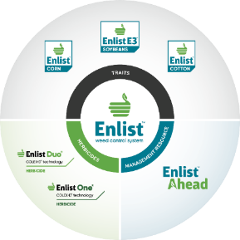
Enlist Weed Control System
Corteva Agriscience™ sells and services the entire system: Enlist® traits and Enlist® herbicides.
The Enlist® weed control system launched responsibly.
Enlist® Ahead launched in 2012, our commitment to sustainability.
2012
2013
2014
2015
2016
2017
2018
2019
2020
Enlist® Ahead launch
Enlist Duo® herbicide registration
Enlist One® herbicide and Enlist® corn launch
Enlist® cotton launch
Enlist E3® launch

Slide 14
Exceptional weed control to fit your needs
Convenient proprietary blend of 2,4-D choline and glyphosate
Straight-goods 2,4-D choline with additional tank-mix flexibility
- Multiple sites of action in a convenient blend
- Great fit for acres where grass control is needed; works well for burndown
- Improved tank stability for a blend that stays mixed
- Can tank-mix with Liberty® herbicide or glyphosate
- More approved tank-mix partners: residual herbicides, insecticides, fungicides and more
- Flexibility to customize tank mixes to fit each farm’s needs
Both with the on-target benefits of 2,4-D choline with Colex-D® technology

Slide 15
Enlist® Weed Control System is Continuing To Win!!
Proven track record of system
Enlist® herbicides have been sprayed on more than 90 MM acres since 2017
Five consecutive years of growth for Enlist herbicides
U.S. based Enlist One® herbicide supply chain & manufacturing
Confidence in robust supply for Enlist One 2023 growing season
Advantages over dicamba
Near-zero volatility
No calendar cutoff dates
Greater tank-mix flexibility
Effective weed control
Recognize the impact on farmers in certain counties
Work closely with growers on alternate weed management strategies for their Enlist® fields
Submitting additional data wherever feasible so that some of the geographic label restrictions may be removed

Slide 16
Enlist® Ahead commitment to stewardship

Slide 17
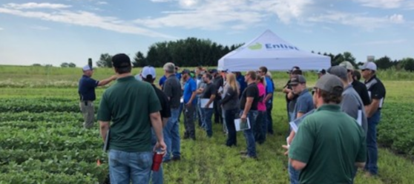
Enlist® Ahead: a pillar of the system from the beginning
Launched in 2012, Enlist® Ahead focuses on weed
resistance management and effective, on-target
herbicide sprays
In 2022, our Enlist Field Specialist team
trained 18,000+ people
Since 2017, 76,000+ people have received training on
Enlist by classroom, in-field, online and webinar training
Key educational assets:
Enlist Field Specialist team
Enlist Product Use Guide and Application Guide
Enlist Ahead online training on Enlist.com
Enlist Ahead Webinar Series
Watch our Enlist Ahead Tech Center Tour

Slide 18
Trait Longevity through Sound Education
7,000 people through online and webinar training
Field Specialist team engagement :
- 240 demo plots/meetings
- 9,500+ in attendance
From day ONE we have stuck to facts, sound science, educational outreach and delivered on expectations.
This Straight Up Approach is still true today!!

Slide 19
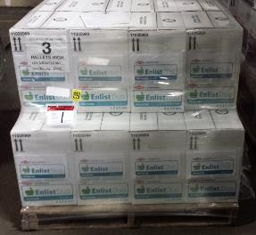
Authorized 2,4-D herbicide for use with Enlist® crops
Enlist One® and Enlist Duo® herbicides with Colex-D® technology are the only 2,4-D herbicides labeled for preemergence and postemergence use with Enlist crops.
The smart choice for in-crop use, with the benefits of reduced drift potential and near-zero volatility.
Use of any other 2,4-D-containing product with Enlist® crops is a violation of the grower Technology Use Agreement.
First pallet of Enlist Duo® herbicide sold in the U.S. in 2015

Slide 20
Best Practices – Coverage & Control
Spray Weeds:
Small (6” tall or less)
Actively growing
Properly identified for proper control
Use:
Full rates for best weed management of difficult-to-control weeds
A qualified nozzle that provides the best possible coverage
Upper end of qualified pressure range
Sufficient water carrier volume
Use Multiple MOA to manage resistance
Application Rate
Enlist One® herbicide | 2 pts/A (32 oz/A)
Enlist Duo® herbicide | 4.75 pts/A (75 oz/A)
Use Rates equivalent to 1.0 lb ae/A applied
2023 Enlist Product Use Guide

Slide 21
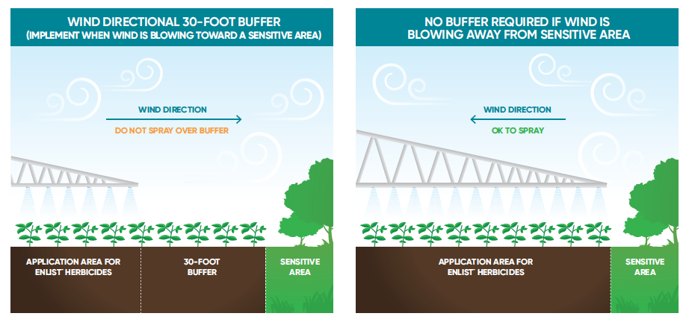
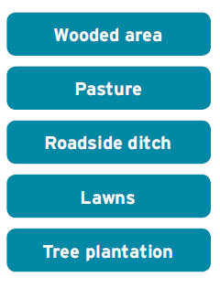
Wind directional buffers to protect sensitive areas
Sensitive area examples
As stated on the label, “You must maintain a 30-foot downwind buffer (in the direction in which the wind is blowing) from any area except:
Roads, paved or gravel surfaces
Planted agricultural fields (except those crops listed in the Susceptible Plants section)
Agricultural fields that have been prepared for planting
Areas covered by the footprint of a building, shade house, silo, feed crib or other man-made structure with walls and or roof
Label mandates a 30-foot downwind buffer to protect sensitive areas.

Slide 22
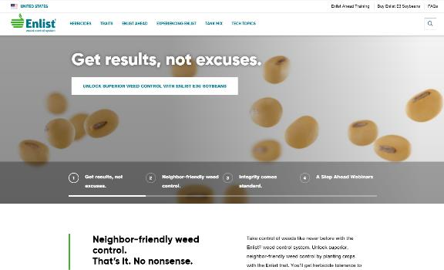
Find More Resources at Enlist.com
Enlist® Ahead training (link at top of site) for additional webinar sign ups and webinar recordings
Tank mix partner list
Enlist Ahead Information
Product Use Guide – illustrated label
Application Guide – checklist reference
Tank mix sequence guidance
Additional literature pieces
Runoff management
Pollinator protection
Endangered species protection measures
Weed resistance management guidance

Slide 23
Weed management with the Enlist® system

Slide 24
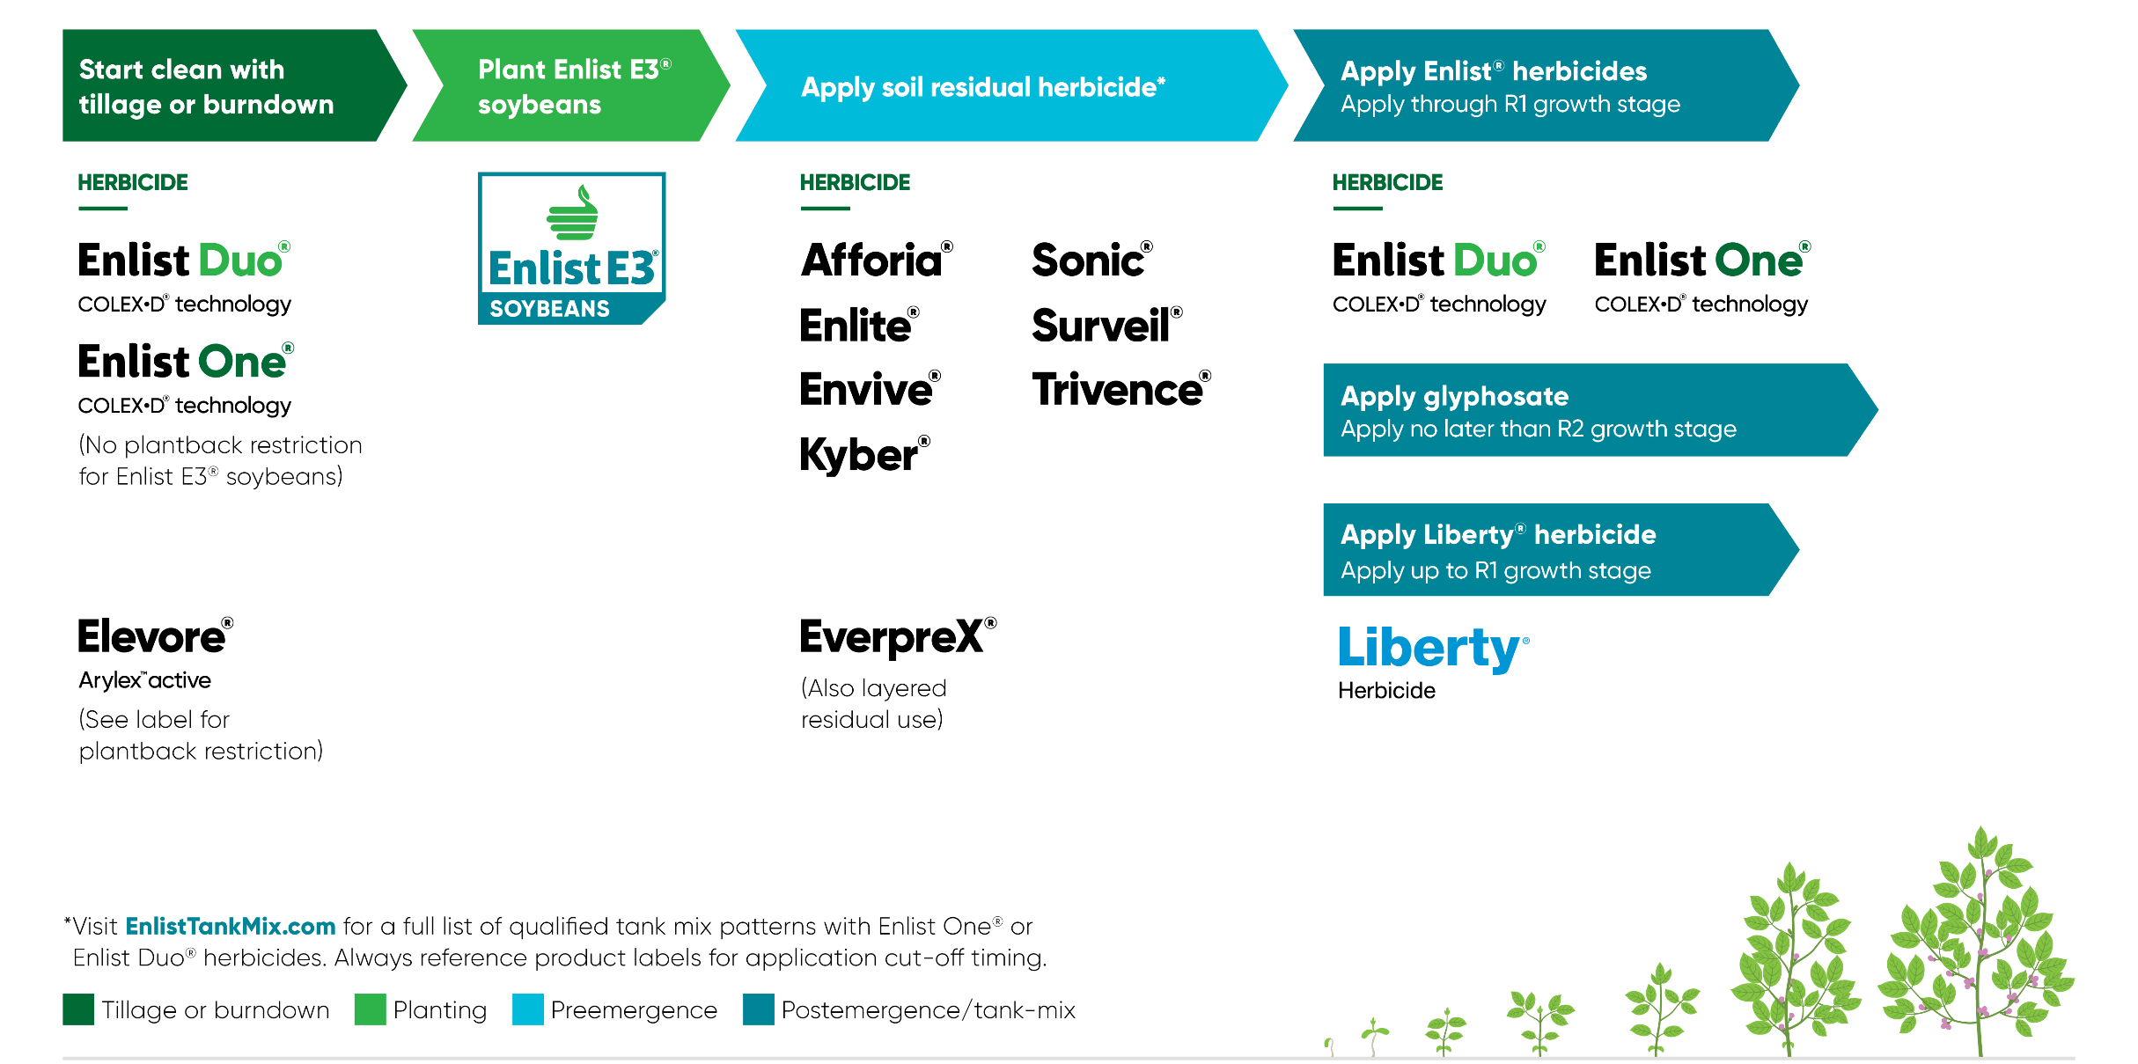
Designing a program approach in Enlist E3® soybeans

Slide 25
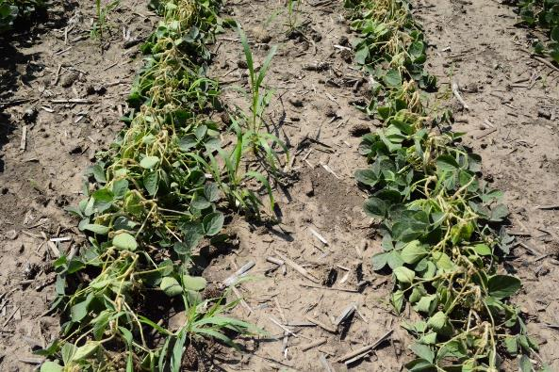
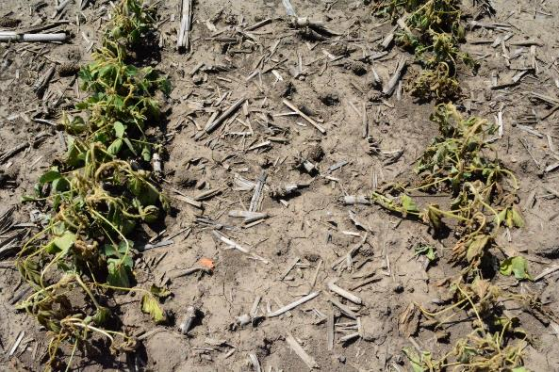
NO cross-tolerance between Enlist E3® soybeans and Xtend®
Enlist E3® soybeans sprayed with 1X rate of Engenia® (dicamba)
Roundup Ready® Xtend soybeans sprayed with 1X rate of Enlist Duo® herbicide

Slide 26
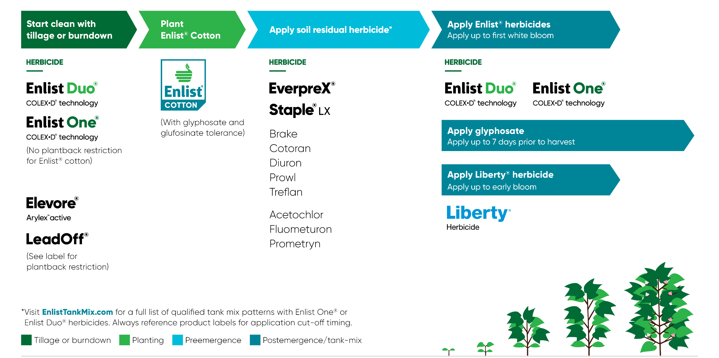
Designing a program approach in Enlist Cotton

Slide 27
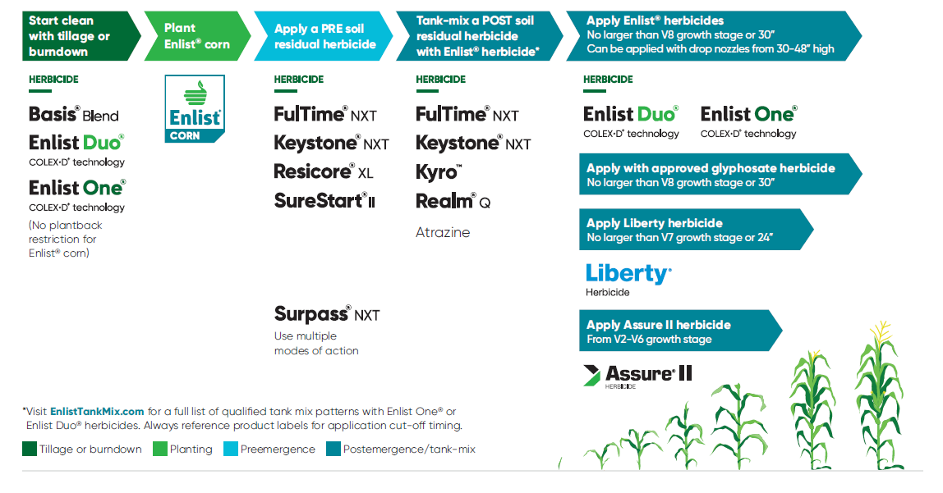
Designing a program approach in Enlist Corn

Slide 28
Tank-mix Options: Glyphosate or Liberty® Herbicide?
Consider: weed pressure, weather conditions, agronomics, full-season weed management plan?
 | Glyphosate | Liberty® herbicide | Both
Pros | Better for grass control than glufosinate Application window through R2 | Most effective post mix on resistant weeds (incl. waterhemp, pigweed) No true Liberty® herbicide resistance documented Strong broadleaf control relative to grass control Best option for kochia | 3 sites of action in one pass
Cons | Less activity on glyphosate-resistant weeds (incl. waterhemp, pigweed) | Application window no later than R1 Needs higher humidity conditions for best performance - spray dawn to 2 hr before sunset for optimal weed control Cost of glufosinate compared to glyphosate | May have reduced activity on grasses Highest cost per acre Increased potential for speckling crop response

Slide 29
Check EnlistTankMix.com for tank mixes
Qualified tank-mix partners ARE:
Products that passed the EPA-mandated drift testing protocol.
One reason for the testing protocol for drift is protecting sensitive areas where endangered species may have habitat
Qualified tank-mix partners ARE NOT:
Tested for crop response
Tested for physical tank-mix compatibility
An agronomic recommendation from Corteva Agriscience™
An endorsement of any kind from Corteva
An indicator of performance
Enlist Duo® and Enlist One® herbicides may only be tank-mixed with products that have been tested and found not to adversely affect the spray drift properties of the Enlist® herbicides. A list of those products may be found at EnlistTankMix.com. Enlist One offers additional tank-mix flexibility with products such as Liberty® herbicide.
Products listed on EnlistTankMix.com have not been tested for crop response, e.g., leaf burn. The addition of tank-mix products may cause increased crop response. Applications of products containing crop oils or vegetable-based oils are more likely to result in a crop response. Listing does not imply endorsement of use.

Slide 30
Enlist® herbicides Characteristics

Slide 31
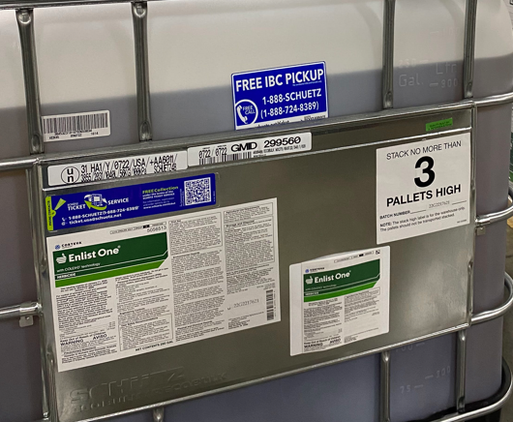
Enlist® herbicides: 2,4-D choline with Colex-D® technology
Enlist® herbicides are different than 2,4-D ester, amine and other traditional formulations:
Near-zero volatility
Reduced physical drift potential
Better handling characteristics
Watch the Enlist Story to learn more about what’s behind 2,4-D choline innovation.

Slide 32
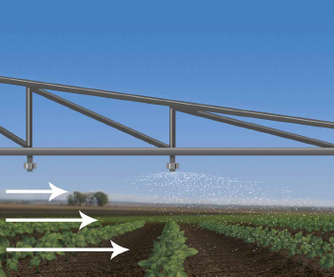
Types of off-target movement
Physical Drift
Volatility
Movement of driftable fines from spray boom away from intended spray target, before it reaches target
Movement of particles via vapor loss after spray hits target

Slide 33
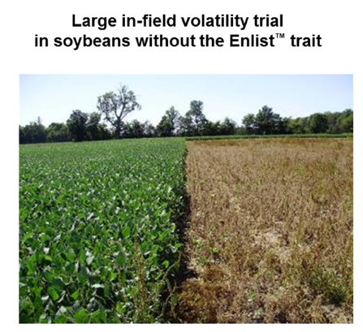
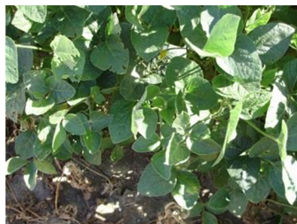
In-field research confirms inherent low volatility of 2,4-D choline
®
Adjacent soybeans without the Enlist® trait
Soybeans without the Enlist® trait sprayed with 2,4-D choline at 4x single rate
Soybeans adjacent to sprayed area had no visible damage from volatility

Slide 34
Key Differentiation: Near-zero volatility
98% less volatile
Enlist Duo® herbicide provides ultra-low volatility compared with a tank mix of BAPMA dicamba and glyphosate.
On an acid-to-acid basis
2,4-D is 236x less volatile than dicamba.

Slide 35
Key Differentiation: Stability enables tank-mix partners
Consider these products which CAN be tank-mixed with
Enlist® herbicides:
Glyphosate
Liberty® herbicide with Enlist One® herbicide
Qualified ammonium sulfate (AMS) products
Adding acidic products or AMS Does Not “break” the inherent low-volatility characteristics of 2,4-D choline

Slide 36
Reduction of drift potential
Used with labeled low-drift nozzles, Enlist® herbicides with Colex-D® technology reduce physical drift potential by 90% compared with a tank mix of traditional 2,4-D and glyphosate.
Reduces driftable fines without increasing relative droplet size
Helps Enlist herbicides land and stay on target
Tank mix of glyphosate +
traditional 2,4-D
Enlist Duo® herbicide with
Colex-D® technology

Slide 37
Key Differentiation: Tank-mix partners
Prescribed drift-reducing adjuvants (DRAs) and volatility reducing adjuvants (VRA’s) are NOT REQUIRED with Enlist® herbicides or other qualified Enlist tank-mix partners.
No prohibition on AMS; in fact, AMS recommended with Liberty® herbicide tank mix, and as needed with glyphosate tank mix
More insecticides & fungicides on the qualified tank-mix list than with in-crop dicamba products!

Slide 38
Enlist® Herbicide Label Highlights

Slide 39
Comparing trait herbicide systems
 | Enlist® herbicides | In-crop dicamba herbicides
Application window in soybeans with respective trait? | Through R1 stage | Federal label cut-off date of June 30
Ability to tank-mix with qualified glufosinate? | Yes, Liberty® herbicide qualified as a tank-mix partner with Enlist One® herbicide | No qualified glufosinate tank-mix products
Ability to tank-mix with qualified AMS? | Yes, qualified AMS tank-mix partners listed on EnlistTankMix.com | AMS prohibited from tank-mixing
Glyphosate blend product option available with system? | Yes, Enlist Duo® herbicide is a proprietary blend of 2,4-D choline plus glyphosate with Colex-D® technology | No glyphosate premix products available within system
Herbicide applications if soybeans without the respective trait are downwind? | Soybeans without the Enlist trait are NOT a susceptible crop – can make an application of Enlist herbicides when soybeans without the Enlist trait are adjacent downwind | Soybeans without the Roundup Ready® Xtend trait ARE a sensitive crop – cannot make an application when soybeans without the Xtend trait are adjacent downwind
Time-of-day application limitation? | No | Yes, applications only from 1 hour after sunrise to 2 hours before sunset
Required VRA / pH buffering agent in tank-mix? | No VRA required, inherent near-zero volatility with 2,4-D choline in Enlist herbicides | Yes, a product listed as an approved volatility reduction adjuvant / pH buffering agent must be include in every application
Federal Restricted Use Pesticide | No | Yes

Slide 40
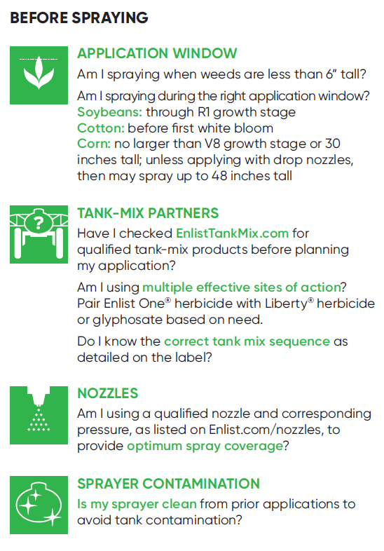
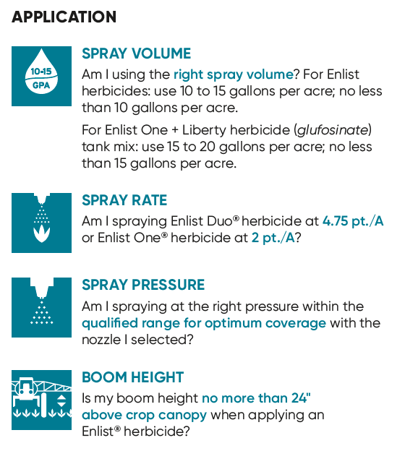
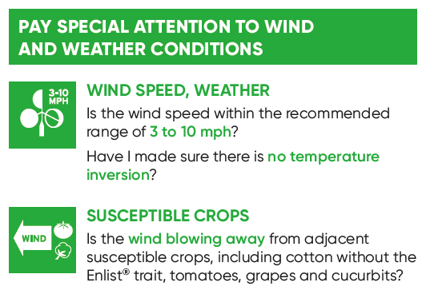
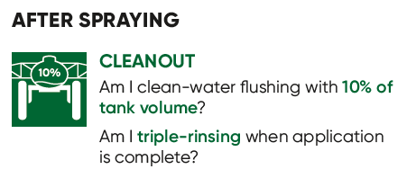
Application Guide

Slide 41
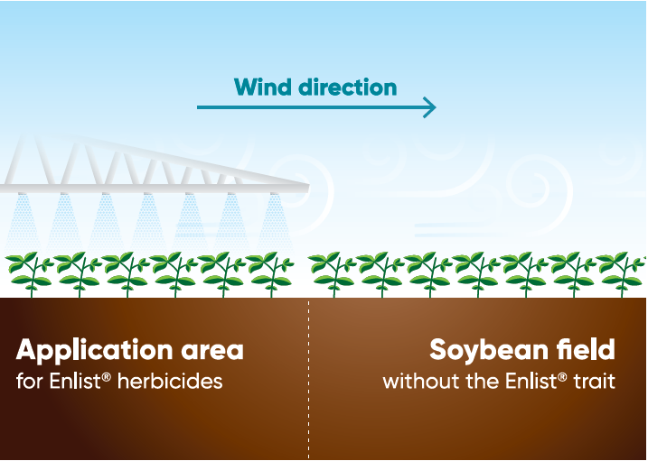
Know the compatible crops
Key crops that are not listed as susceptible on the Enlist® herbicide labels:
Soybeans
Corn
Wheat
Alfalfa
Rice
Peanuts
Sorghum
No wind directional restrictions
As with any herbicide, do not apply if conditions are favorable to promoting drift onto a neighboring field. Be sure to follow best management practices when applying Enlist Duo® or Enlist One® herbicides.

Slide 42
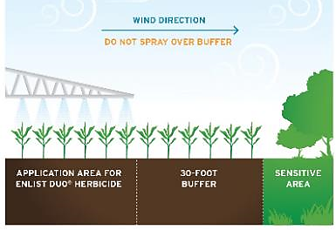
Sensitive area buffers
Sensitive area buffers ARE:
A requirement from EPA to protect potential endangered species habitat areas
Sensitive area buffers ARE NOT:
Meant to protect downwind adjacent susceptible crops – including non-Enlist® cotton
Wooded area
Sensitive area examples
Pasture
Roadside ditch
Lawns
Application area for Enlist herbicides
30’ downwind buffer
Downwind
sensitive area

Slide 43
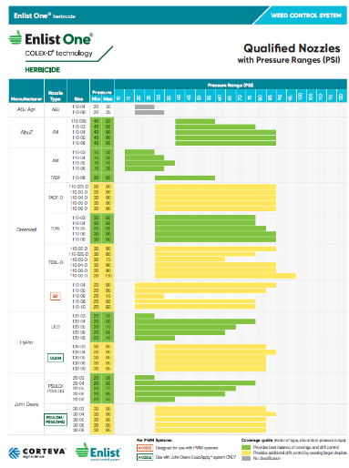
Spray GPA, Nozzles and Pressure
Spray nozzle and orifice size directly affects many spray quality factors:
- uniformity of spray coverage
- spray droplet size and spectrum
- spray drift potential
Corteva therefore highlights which nozzles, pressure and orifice sizes give optimal coverage vs. those that give greater drift potential.

Slide 44
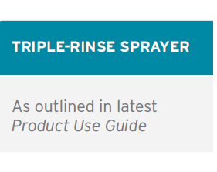
Sprayer cleanout – sanitizing all equipment
Ensure all equipment is thoroughly cleaned after application to avoid contamination. Sometimes it’s the small parts that present the biggest risk for being overlooked.
In addition to the sprayer, keep pumps and other transfer equipment clean
At the beginning of the season, be sure all equipment was cleaned after its last use
Don’t let the spray solution sit in the sprayer over night
Pay close attention to hoses, screens, filters, pumps and dead ends on the boom
The triple-rinse procedure is detailed on the Enlist® herbicide labels and the Sprayer Cleanout Guide on Enlist.com in the Enlist Ahead® section.

Slide 45
Farmer feedback

Slide 46
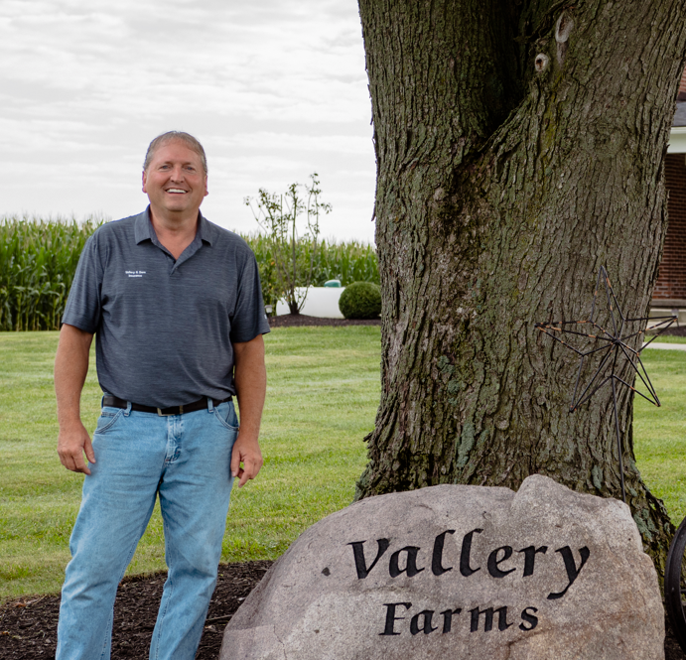
Experiencing Enlist
Paul Butler - Illinois
The last two years, we’ve had the best yields we’ve ever had,” Butler says. “I was so happy with that first year that we planted 100% Enlist the second year. I was thinking that was just going to be a one-time thing, but our fields were really clean, so we went 100% again. Now we’ve covered all our acres.”
Mike Vallery- Ohio
To help him manage those problem weeds, he works with a local ag services consultant
to set up custom applications when he needs them.
“I rely on my custom applicator to make applications on time — at the right rate and right weed height,” Vallery says. “I’m trying to be a good steward of the land for generations to come, and working with a custom applicator helps me manage my weeds and weed resistance.”

Slide 47
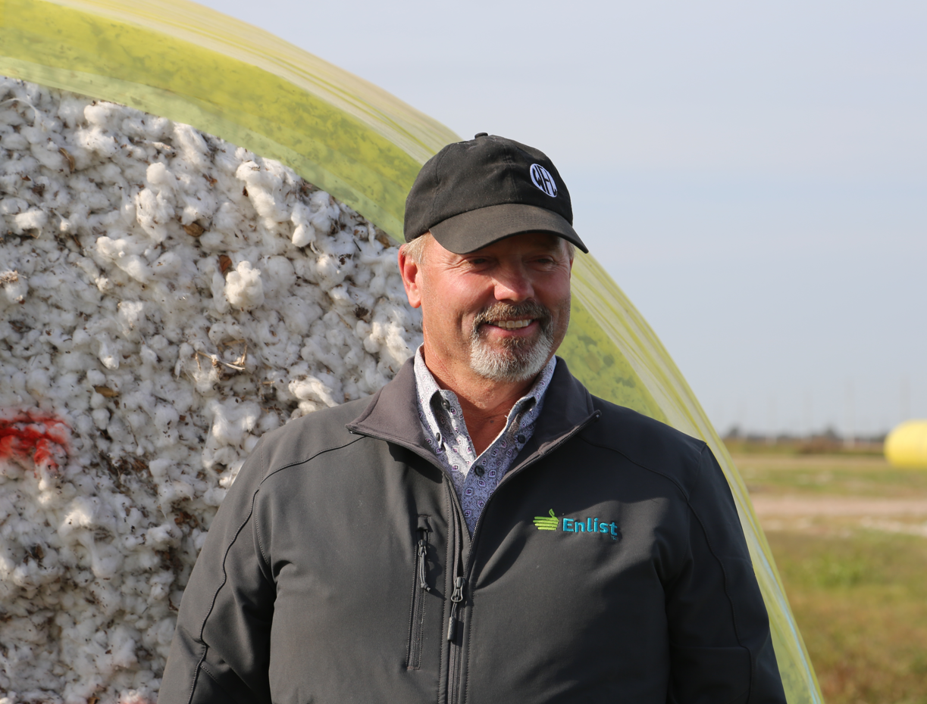
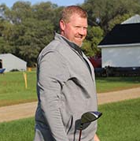
Experiencing Enlist
Jay Wilder - Texas
“Ultimately, the weed control results and the chemistry to help us manage our resistant weeds is why we decided to test out Enlist,” Wilder says. “Then we worked closely with our entomologist and PhytoGen rep to figure out the specific cotton varieties with the Enlist trait that fit our acres best.”
Ryan Vaksdal – South Dakota
“It’s simpler to use than the other system. With the dicamba system, there are minimal days you can spray and that poses a challenge. In my opinion, the risk wasn’t worth the reward,” Vaksdal says. “As farmers, we’re under the microscope. Using chemistry that volatilizes and moves off target is not being a good steward of the land. That was a big part of why we chose to switch to the Enlist system.”

Slide 48
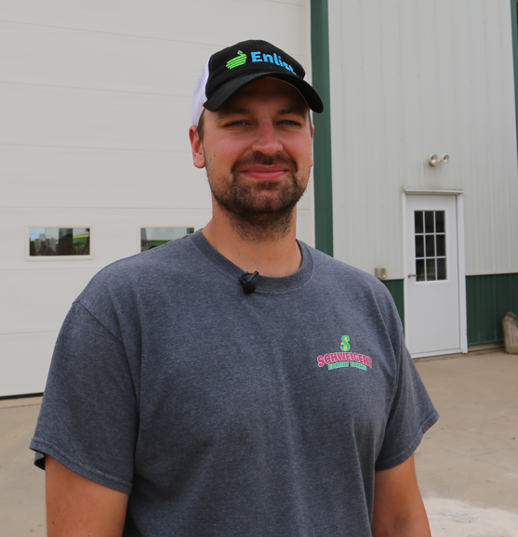
Experiencing Enlist
Jeremy Heitmann - Nebraska
“We can mix multiple modes of action to go after these tough weeds that we struggled to get. Palmer is the big one that we struggle the most with. And then waterhemp and that family of weeds is getting tougher to control,” Corey says. “We strive to get the weeds when they’re little. We’ve built a program that’s all based on that — go early, go small.”
Joe Schweigert – Wisconsin
“If it’s not controlled properly, you can end up having a disaster pretty quickly,” Schweigert says. “We run a two-pass approach with a pre and a post to tackle waterhemp. Enlist herbicides give more of a knockdown punch than other products. If you come back in a couple hours, you can already see the weeds wilting. It’s a good feeling to get that instant feedback.”

Slide 49
Enlist® Weed Control System is Continuing To Win!!
Proven track record of system
Enlist® herbicides have been sprayed on more than 90 MM acres since 2017
Five consecutive years of growth for Enlist herbicides
U.S. based Enlist One® herbicide supply chain & manufacturing
Confidence in robust supply for Enlist One 2023 growing season
Advantages over dicamba
Near-zero volatility
No calendar cutoff dates
Greater tank-mix flexibility
Effective weed control
Recognize the impact on farmers in certain counties
Work closely with growers on alternate weed management strategies for their Enlist® fields
Submitting additional data wherever feasible so that some of the geographic label restrictions may be removed

Slide 50
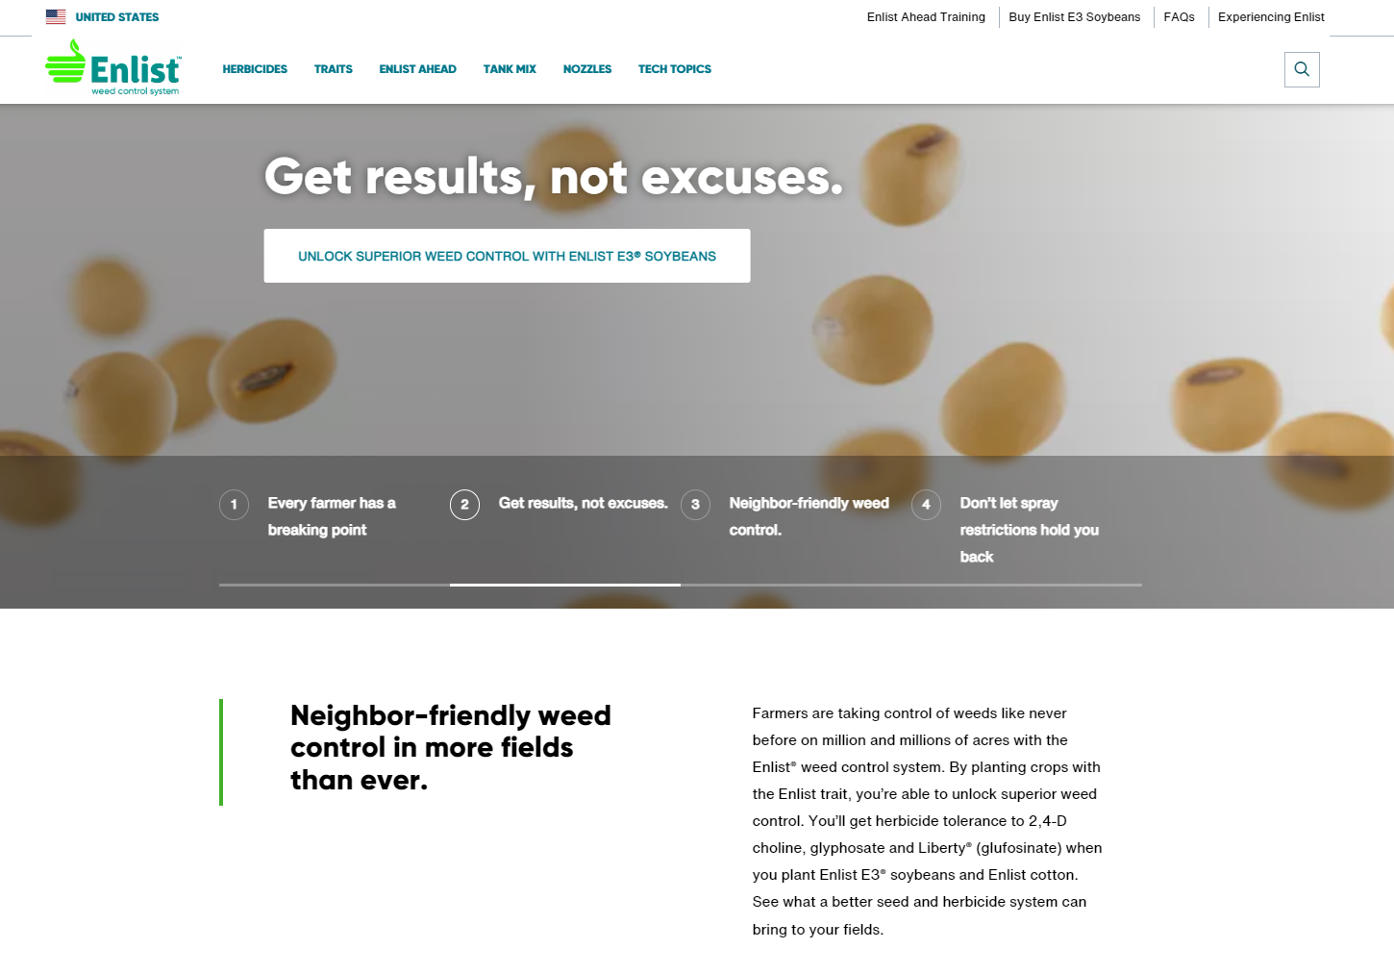
Find More Resources at Enlist.com
Enlist® Ahead training (link at top of site) for additional webinar sign ups and webinar recordings
Tank mix partner list
Enlist Ahead Information
Product Use Guide – illustrated label
Application Guide – checklist reference
Tank mix sequence guidance
Additional literature pieces
Runoff management
Pollinator protection
Endangered species protection measures
Weed resistance management guidance

Slide 51
Labels, resources, grower stories and more:
Enlist.com
®™Trademarks of Corteva Agriscience and its affiliated companies.
This reference guide is not intended as a substitute for the product label for the product(s) referenced herein. Product labels for the above product(s) contain important precautions, directions for use, and product warranty and liability limitations, which must be read before using the product(s). Applicators must be in possession of the product label(s) at the time of application. Always read and follow all label direction and precautions for use when using any pesticide alone or in tank-mix combinations. Not all products are registered for sale or use in all states or counties. Contact your state pesticide regulatory agency to determine if a product is registered for sale or use in your area. The transgenic soybean event in Enlist E3® soybeans is jointly developed and owned by Corteva Agriscience LLC and MS Technologies LLC. Enlist Duo and Enlist One herbicides are the only 2,4-D products authorized for use with Enlist crops. Consult Enlist herbicide labels for weed species controlled. Always read and follow label directions. Liberty is a registered trademark of BASF. Assure II is a trademark of AMVAC Chemical Corporation. All other trademarks included are the property of their respective owners. © 2023 Corteva. COR (06/23)

